Slide 1

LANDSPITALI
The National University Hospital of Iceland
Date:
Name:

Slide 2
Agenda
Health Care
in Iceland
Landspitali
Organization
Operations
New hospital building

Slide 3
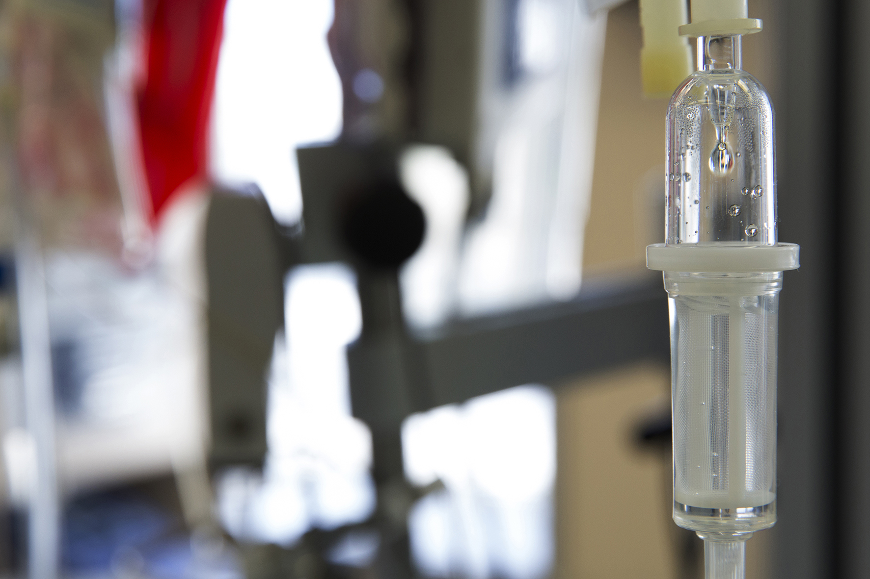
Health care in Iceland

Slide 4

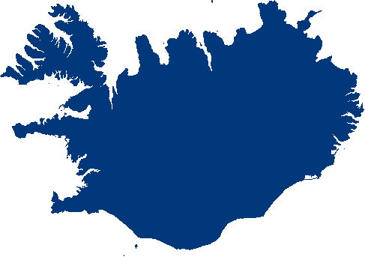
The Icelandic Health Care System
Icelandic population 389.000 (Jan. 2025)
  249.000 in the capital area
Health sector counts for 8,74% of GDP
Financing of health services
  83,7% through taxes and 16,3% by individuals
Good clinical results in comparison to
other OECD nations

Slide 5
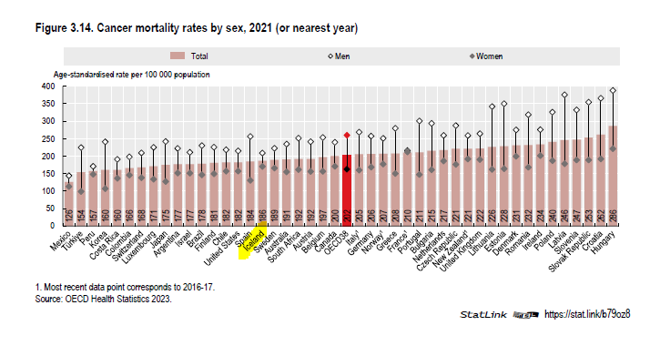
Low cancer incidence and mortality Iceland vs. OECD

Slide 6
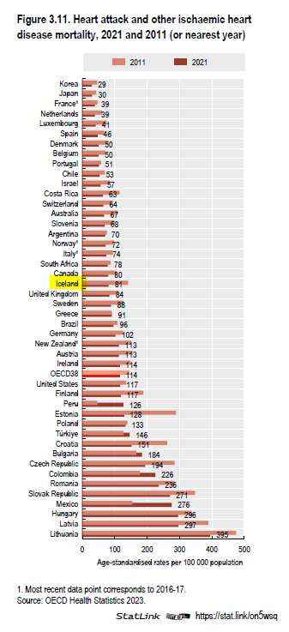
Low heart attack and Ischaemic heart disease mortality
Iceland vs. OECD

Slide 7
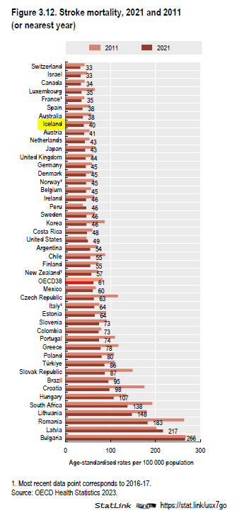
Low stroke mortality
Iceland vs. OECD

Slide 8
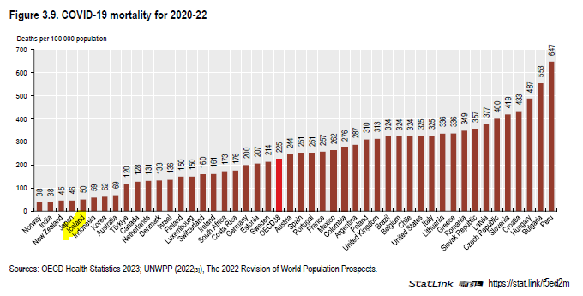
LOW COVID-19 MORTALITY

Slide 9
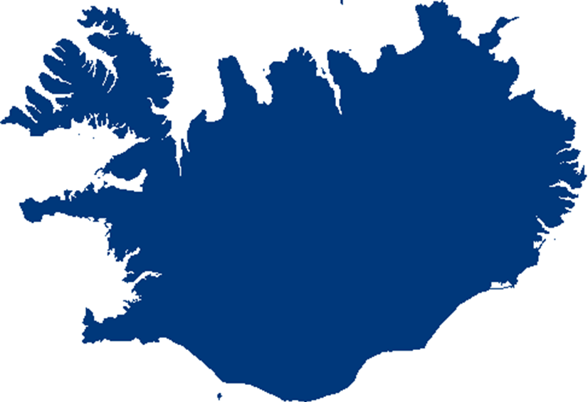
The Icelandic Health Care System
One university hospital
One teaching hospital
Several small rural hospitals, primary care, nursing homes
Primary health care centres
Private practices
Financing
  National health insurance
  Fixed budgets
  Fee for service, private practices
EHR and diverse clinical information systems
OeBS system for financial and HR processes

Slide 10
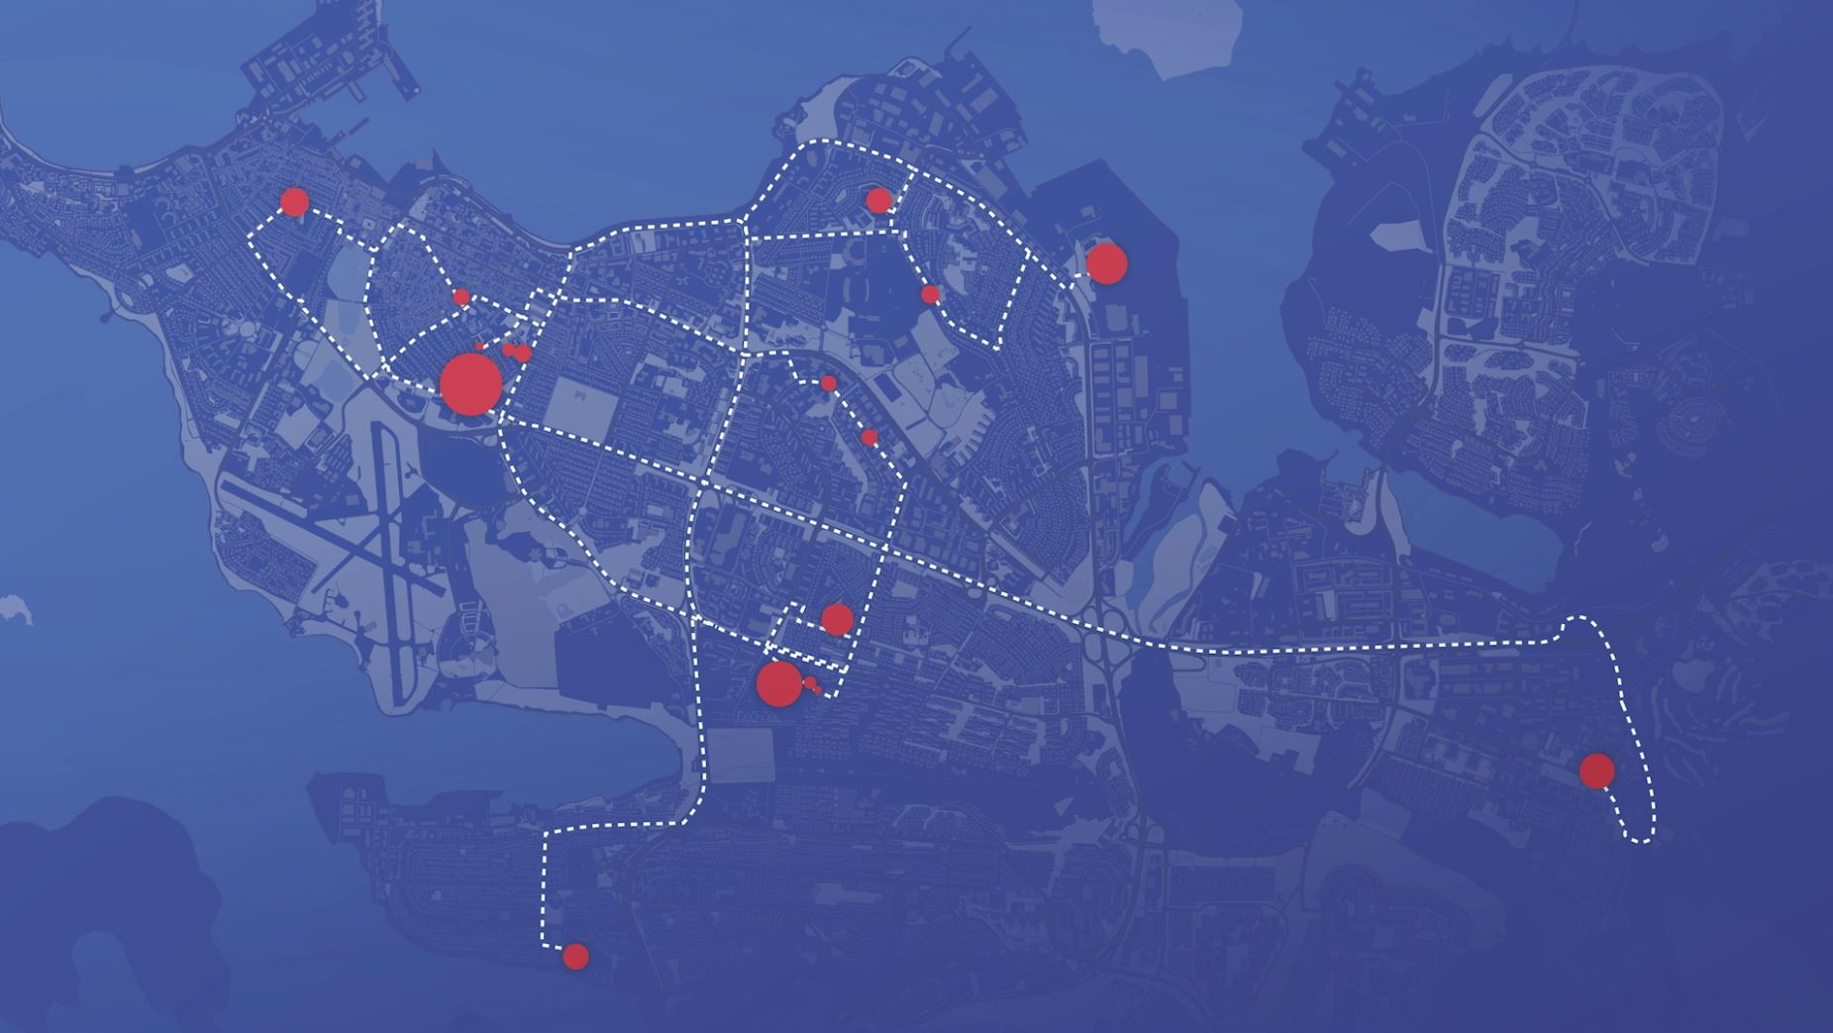
Landspitali
The only university hospital and largest organization in Iceland
6.600 employees
and 2.000 students
in 100 buildings
on 20 sites in the capital
area of Reykjavík...
New CEO in 2008, 2010, 2014 and 2022
Major reorganization in 2009, 2015, 2019 and 2023
Created by a series of mergers
In 1996, 2000 and 2011

Slide 11
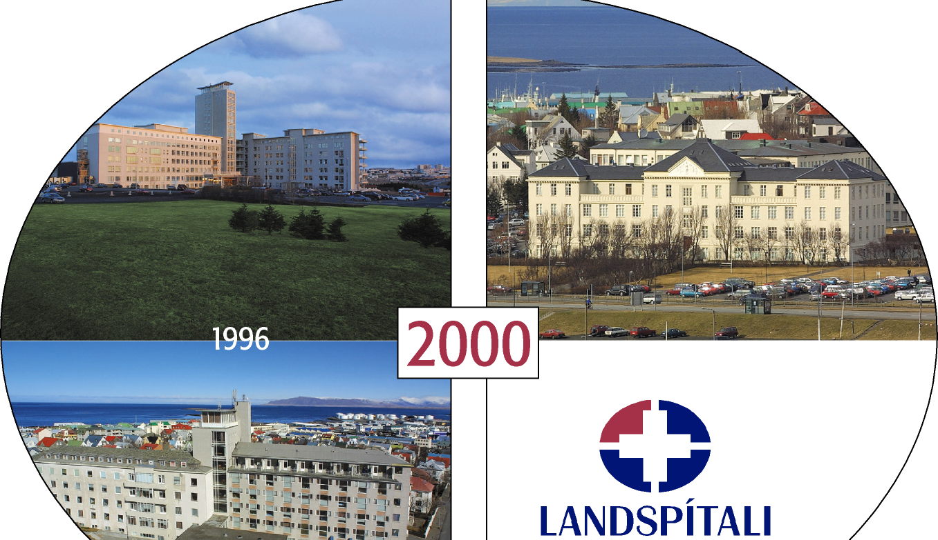

Slide 12
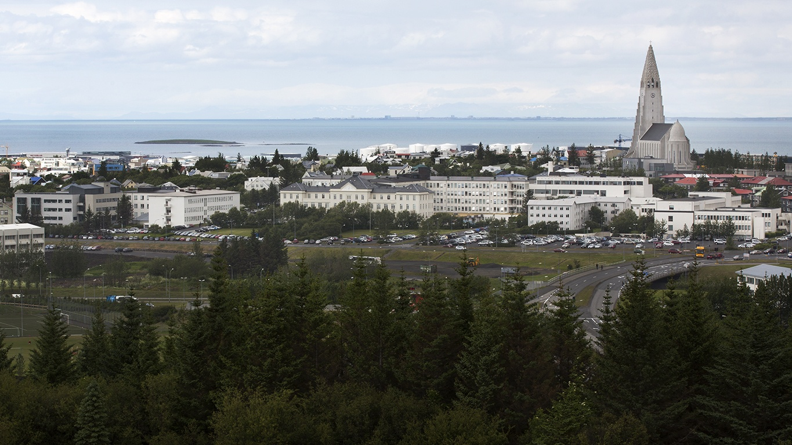
LANDSPITALI - HRINGBRAUT

Slide 13
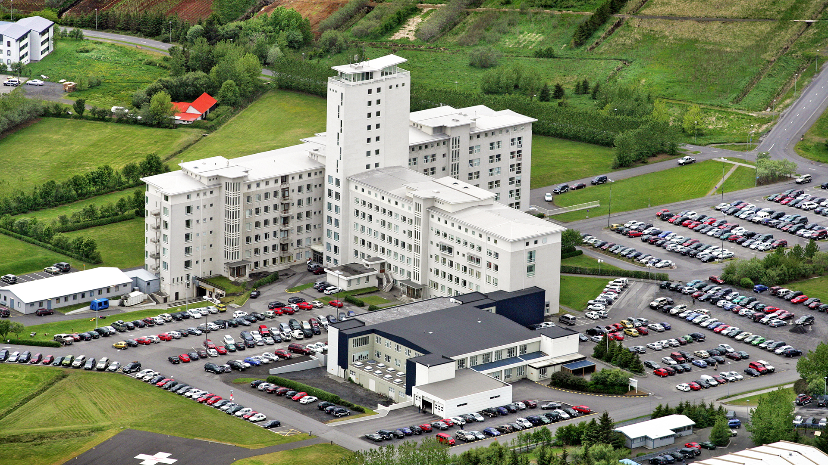
LANDSPITALI
- FOSSVOGUR

Slide 14
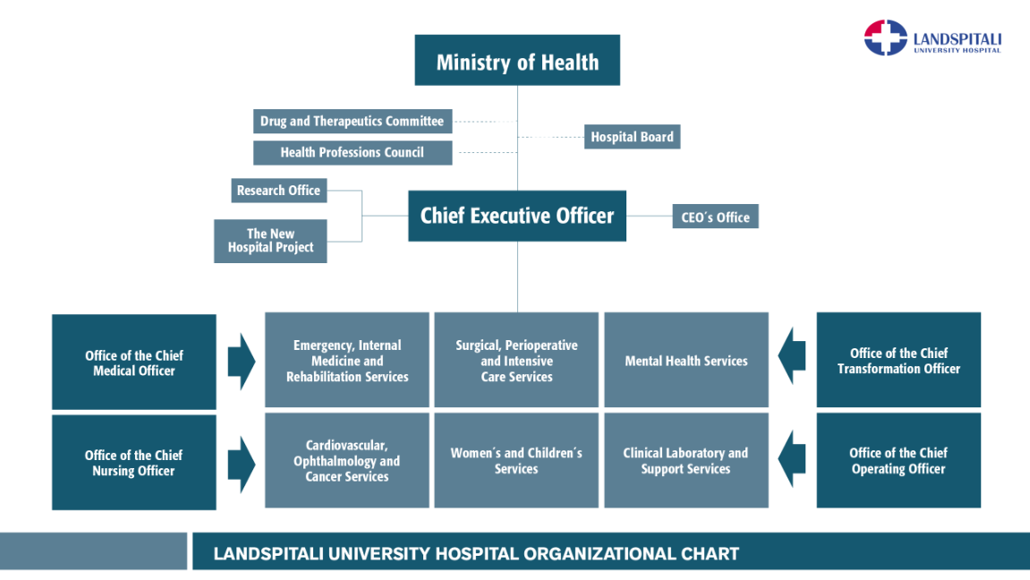

Slide 15
Landspitali
40 medical specialities
Many subspecialities
Medical speciality training abroad
Mostly in Sweden, Norway, USA, UK, The Netherlands
Very few patients sent abroad for treatments
Some heart surgery, some stem cell treatments, PET and solid organ transplants (excl. renal transplants)
Good clinical results
A third of the population served in 2024
Approximately 2.000 students per year
2024 Budget approx 117 billion ISK
848 million USD
784 million EUR

Slide 16

Clinical Service (2023)
94.600 emergency visits
569.000 outpatient services
26.700 admissions
619 hospital beds
4,9 days average length of stay
14.500 surgical procedures
3.057 births

Slide 17
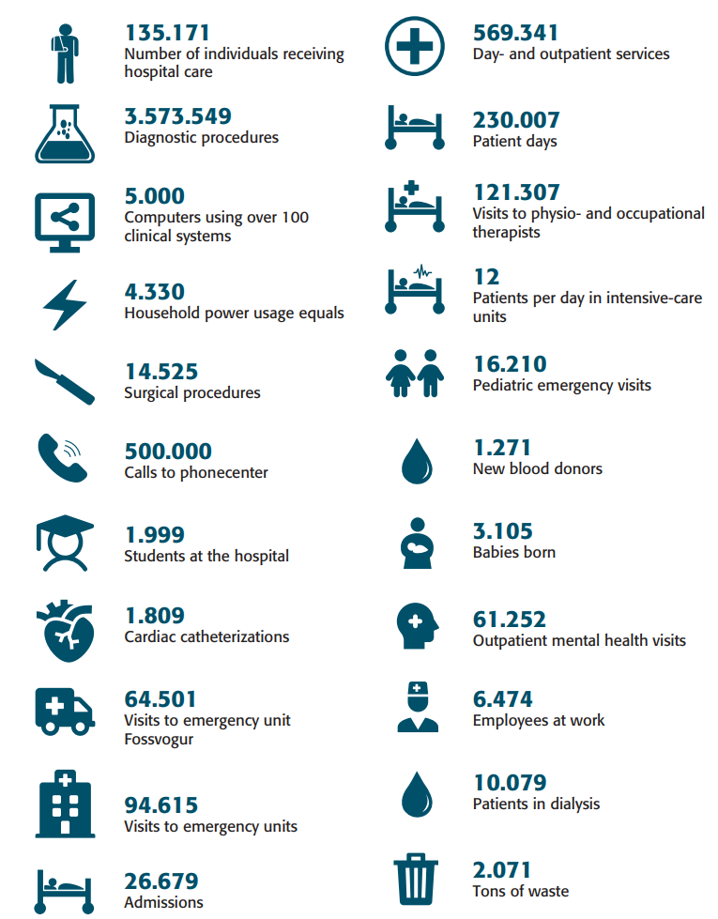
The year 2024
at Landspitali

Slide 18
A TYPICAL DAY AT LANDSPITALI
630 inpatients
2.277 day- and outpatient services
73 new admissions
9.790 laboratory tests
477 visits to physio- and occupational therapists
259 emergency unit visits
40 surgical procedures
9 babies born
44 pediatric emergency visits
7 cardiac catheterizations
33 patients in dialysis
221 outpatient mental health services
12 patients in intensive-care units
3.700 employees at work
5,7 tons of waste

Slide 19
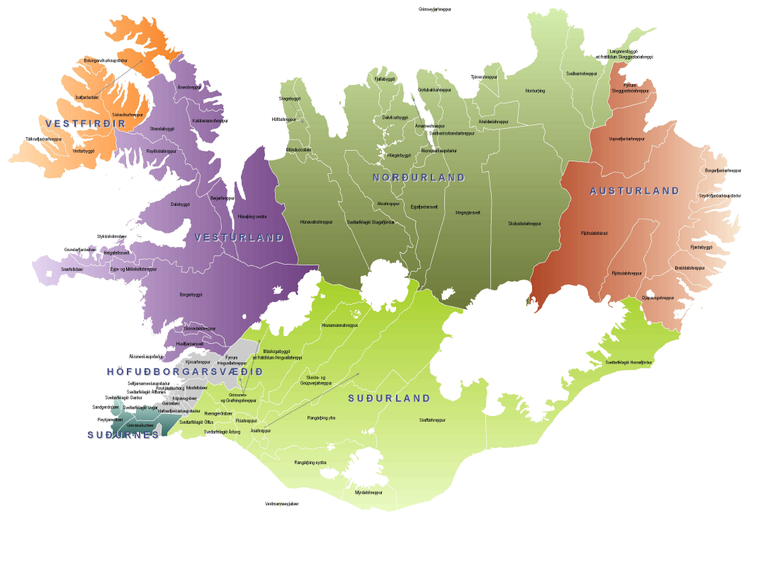
PATIENTS SEEKING HEALTH CARE SERVICE AT LANDSPITALI COME FROM ALL HEALTH DISTRICTS IN THE COUNTRY
Reykjavík

Slide 20
Number of individuals receiving hospital care at Landspítali
Approx. 30 % of Icelanders every year

Slide 21
Average length of stay (days)

Slide 22
Number of visits to emergency units

Slide 23
surgery

Slide 24
Over 70% of all births in Iceland occur at Landspitali

Slide 25
Inpatients; main Diagnostic CatHegories
(of the DRG system)

Slide 26
Quality indicators: Births

Slide 27
Quality indicators: Neurology
Stroke, mortality within 30 days from admission

Slide 28
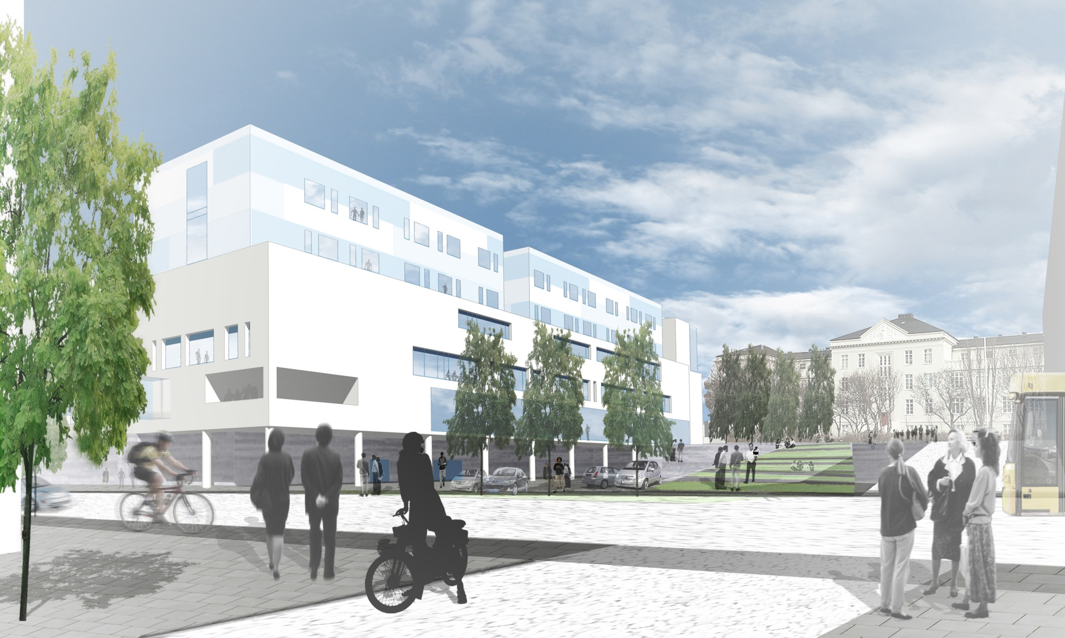
NEW HOSPITAL BUILDING

Slide 29
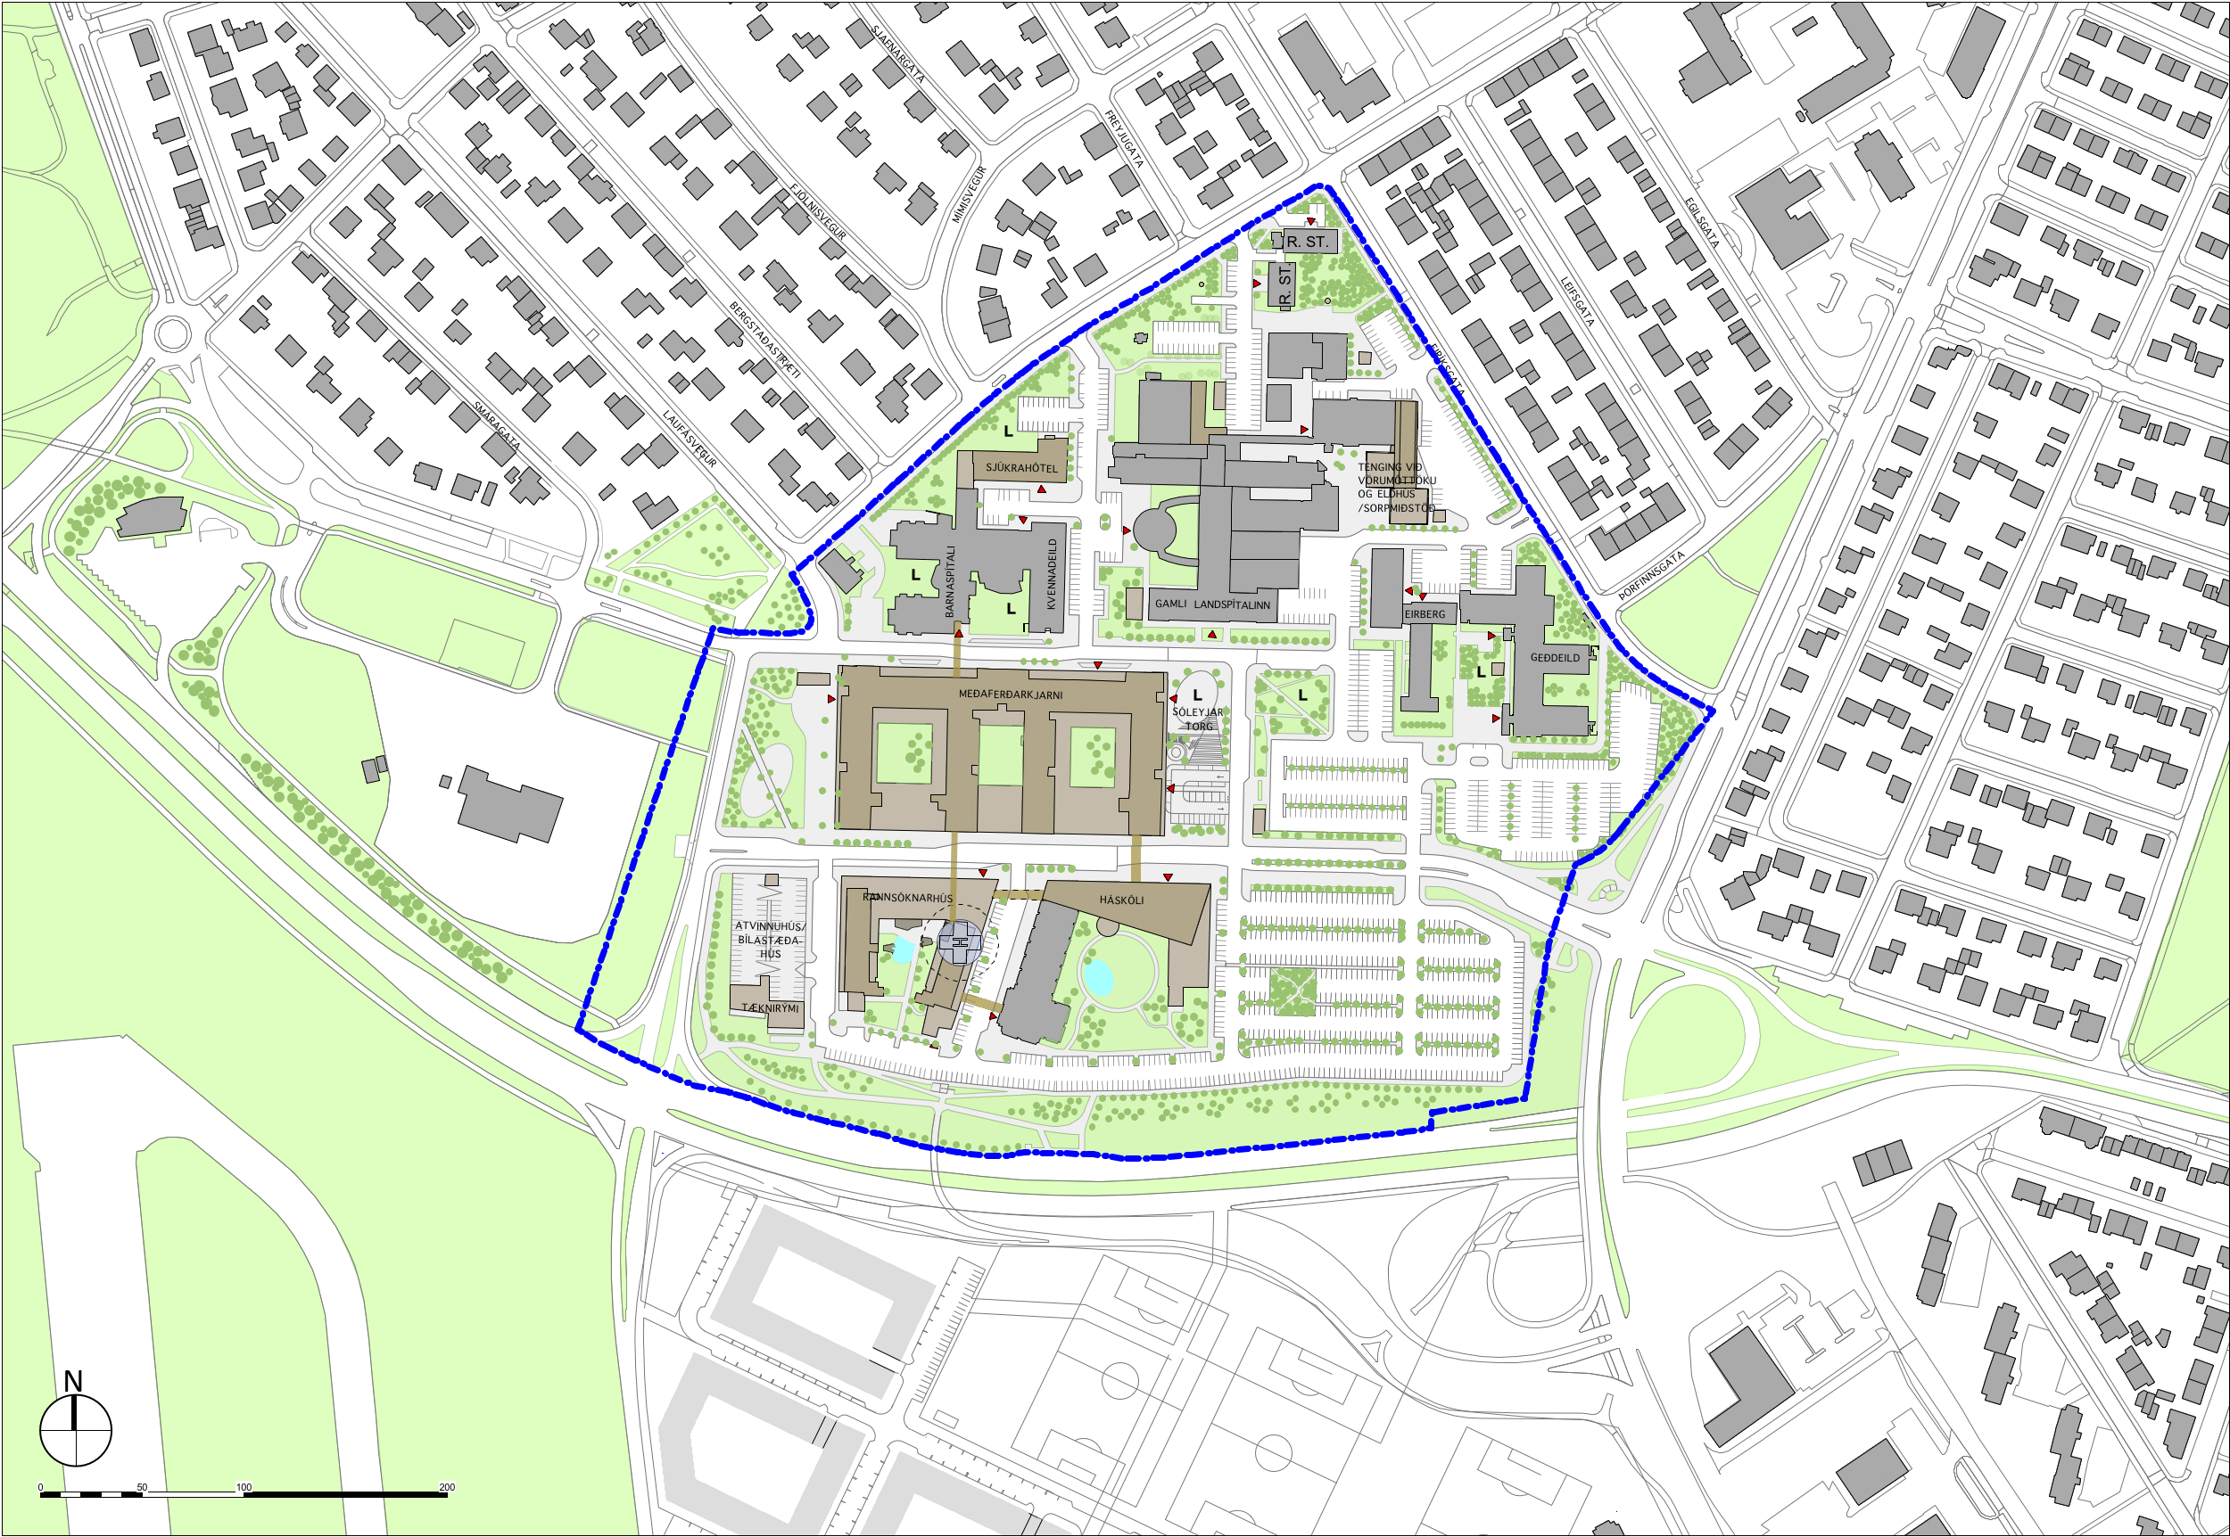
LANDSPITALI – 1. PHASE

Slide 30
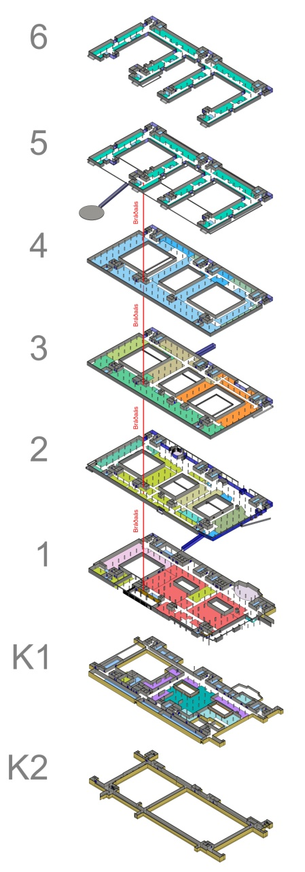
Landspítali – Acute Core / Treatment areas /Bed Wards – 58.500 m²
Bed Wards
Bed Wards
Technical areas / offices
Pre/post, Surgery,
Catherization,
intensive care
Infectious diseases
Diagnostic imaging
Lobby, Cantine
Emerg. Departm.
Pharmacy
PET production
Sterilization
Wardrobes
PET cyclotron
Technical ducts

Slide 31
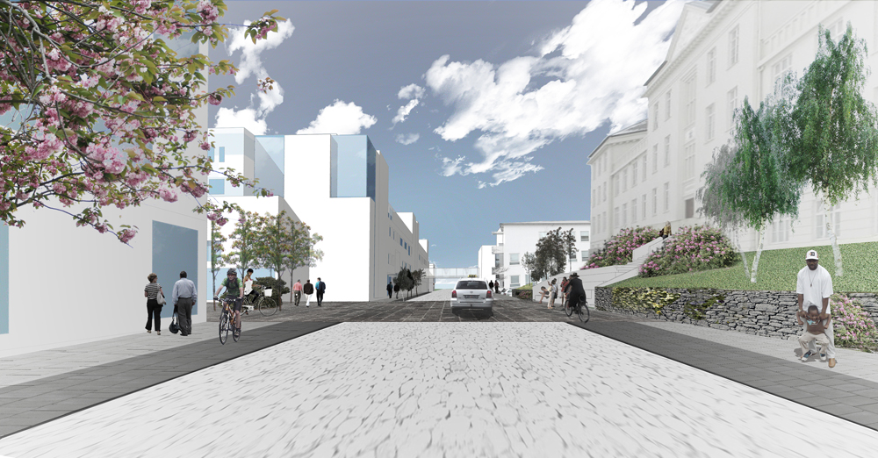

Slide 32


